Slide 1
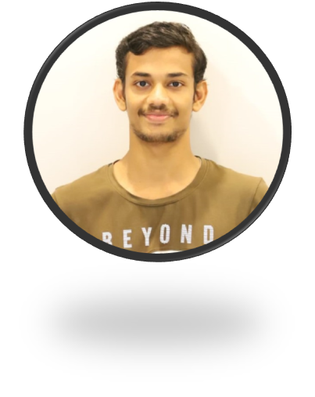
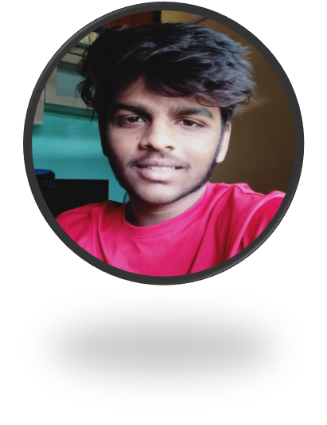

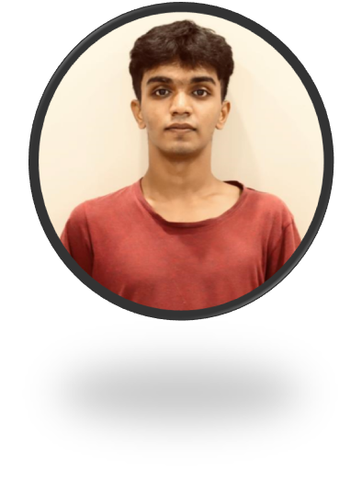




GenZ Pirates
Finalist of Bajaj HackRx 4.0
Participated in Cisco Ideathon 2021
Represented college in Smart India Hackathon (SIH) 2022.
OpenWeaver Ideathon best contender award.
Participated in Cisco Ideathon 2021
Awarded for making efficient AI in HINT
Finalist of IGDC 2021
Participated in Cisco Ideathon 2021
Participated in OpenWeaver Ideathon 2021.
Awarded for good idea in SIH 2021 from college.
Participated in Cisco Ideathon 2021
Finalist of Flipkart grid 1.0

Slide 2
Problem Statement (Manufacturing and Supply Chain):
Genz and India are really excited about Entrepreneurship nowadays. But they lack the knowledge to need to develop a product, Information like Manufacturing on small/large scale, Material requirement, advertisement Ideas, business scalability and others.
New Startups experiences a lot of hectic research and high time consumption for such Information. Even after this time-consuming research it is not guaranteed to get the most correct, trusted and personalized information.
Most of the startup failures occur due to lack of proper knowledge of the industry and most of the upcoming entrepreneurs are clueless about their path.
Manufacturing is one of the key factor which is responsible of the downfall of the new startups.
Hence our app GenZ Connects (B2B) will provide entrepreneurs with the trusted path and direction for Manufacturing on which they can confide and grow up their business.

Slide 3
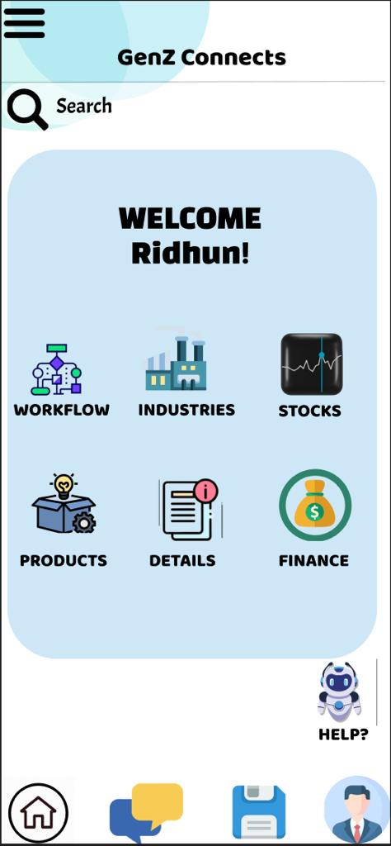
Detailed Description of the Solution:
Our app sugggests GenZ entrepreneurs with 1st tier Manufacturing industries. This gives them access to the expertise and resources they need to develop a product. The app also provides other services that can help GenZ entrepreneurs, such as cost analysis and raw material sourcing.
User Registration and Onboarding: Users will download the GenZ Connect app and create their accounts. They will provide relevant information about their interests, areas of expertise, and business goals during the onboarding process.
Industry and Domain Profiling: The app will have a comprehensive database of 1st tier manufacturing industries, along with detailed profiles outlining their specializations, product categories, and services offered. Users can browse through different industries to find the ones that align with their business ideas.
Product Requirements and Cost Analysis: The app will provide a section where users can input their product ideas and specifications. Using advanced algorithms, the app will estimate manufacturing costs based on the raw materials and production processes required for the product.
Personalized Recommendations: Using machine learning algorithms, the app will offer personalized product suggestions, industry connections, and learning materials based on user preferences and behavior.

Slide 4
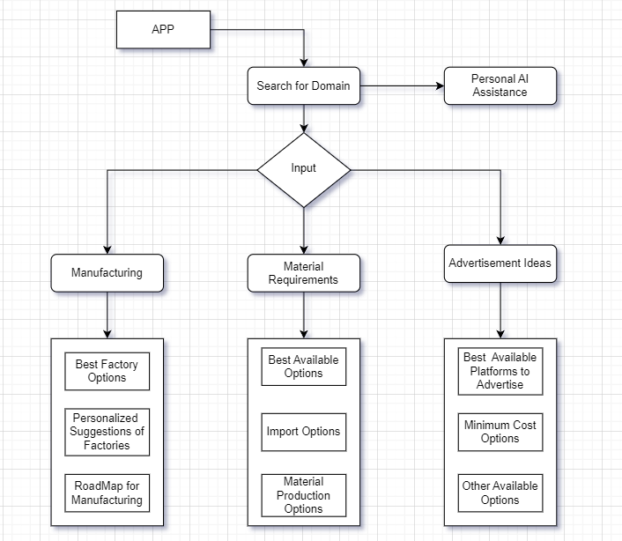
Workflow Diagram:

Slide 5
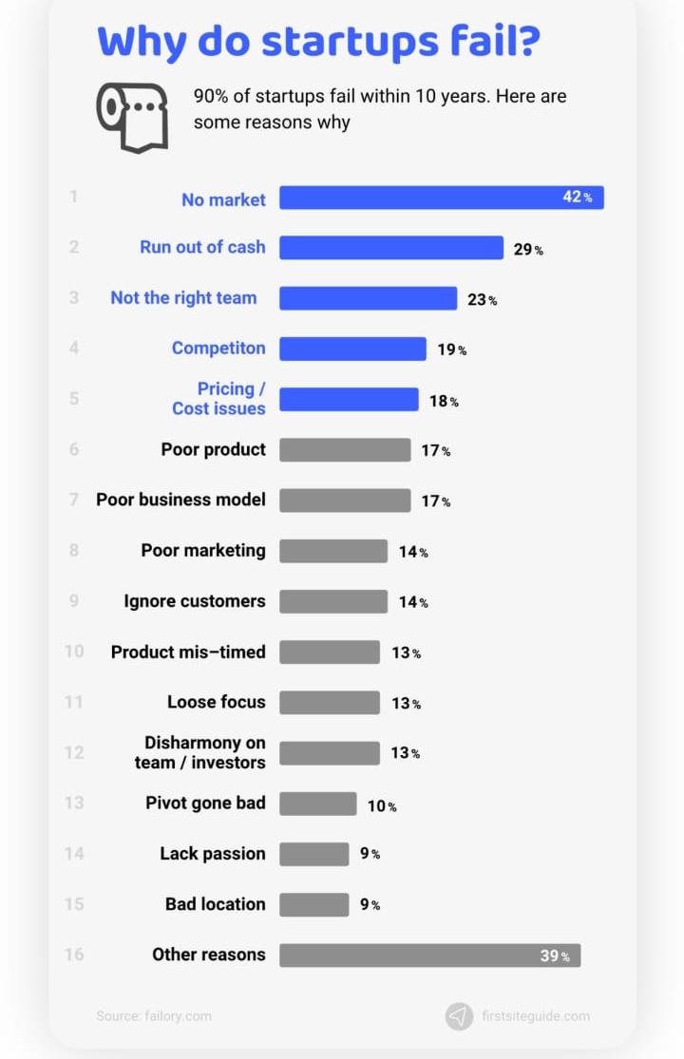
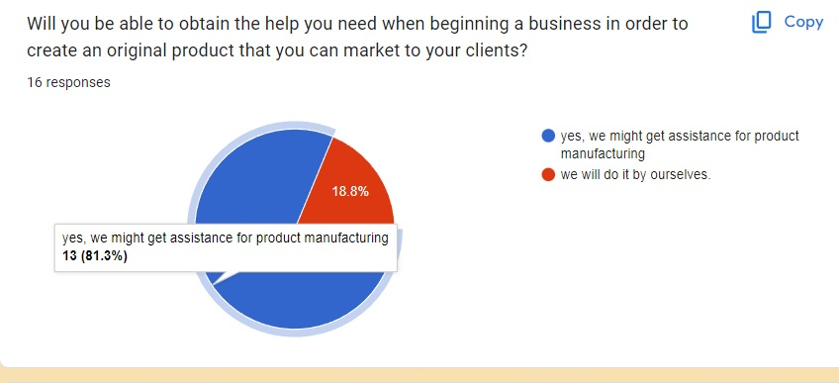
User Research:
The survey by failory.com shows that in manufacturing 17% of the startups fails because of poor product manufacturing and poor business model.
Due to poor manufacturing there are cost related issues that compiles of total 18% of the startup failure and thus they are not able to match the market cap price.
There occur many issues also due to poor manufacturing choices and hence fall into traps which causes loss in the business.
By the survey, we concluded that every 8 out of 10 entrepreneurs need the assistance of someone who can provide the path which will help them carry their business idea.

Slide 6
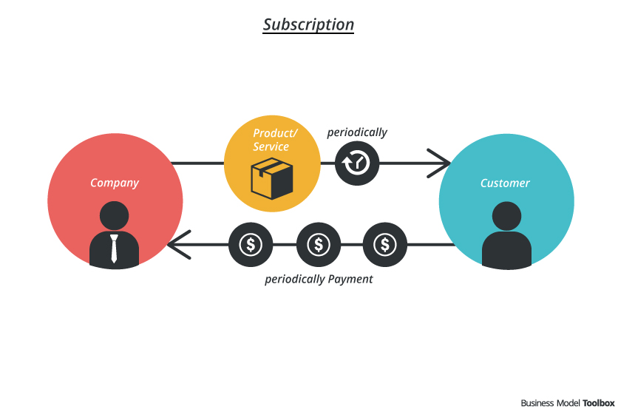
How we earn:
Subscription Model: Offer subscription plans with added benefits to users. Subscribers could get access to exclusive features, early access to industry tie-ups, priority invitations to workshops, and more.
Sponsorships: We can seek sponsorships from manufacturing companies or organizations that wish sponsor their items or domain .
Data Insights and Analytics: Aggregate and anonymize user data to provide valuable insights and trends to manufacturing industries or market research companies for a fee.
Advertisement: Allow relevant businesses and industries to advertise their products, services, or events within the app.

Slide 7
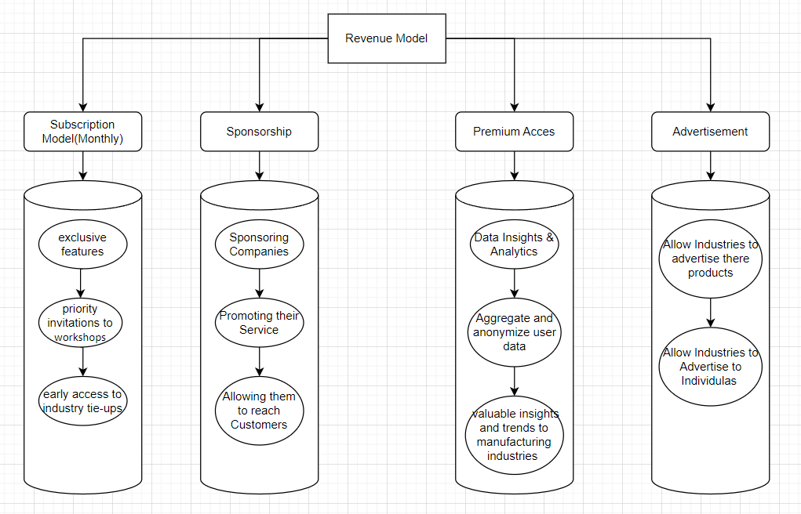
Revenue Model:

Slide 8
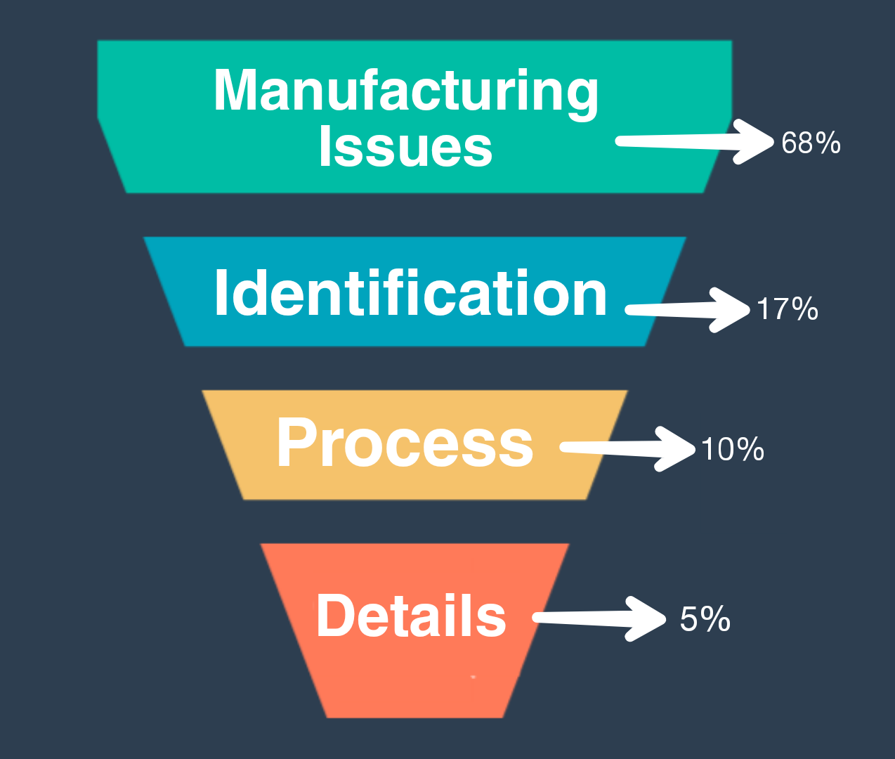
USP of our Product:
Specialized for GenZ and Indian Entrepreneurs: The app is tailor-made to cater to the needs and aspirations of the Gen Z generation and the unique challenges faced by entrepreneurs in India. It understands the preferences, interests, and requirements of this demographic, offering a personalized experience.
Industry and Domain Profiling: GenZ Connect's extensive database of 1st tier manufacturing industries provides detailed profiles, making it easier for users to find and continue with businesses that align with their product ideas and expertise.
Personalization and AI-driven Recommendations: The app utilizes machine learning algorithms to deliver personalized recommendations for industries, products, and learning resources based on user preferences and behavior.
Privacy and Security: Ensuring the safety of user data and providing a secure environment for networking and collaboration is a top priority for GenZ Connect.

Slide 9
Scalability:
Physical Assistance: Users will be provided one on one physical assistance by industry experts about various factors and challenges that can help kickstart their startups.
Industry-Specific Insights and Trends: Provide users with access to real-time industry insights and trends, helping them make informed decisions and stay competitive in rapidly evolving markets.
Industry Challenges and Competitions: Organize industry-specific challenges and competitions to encourage users to innovate and develop unique products. Offer prizes and recognition to winners, driving increased participation and engagement.
Global Entrepreneurship Connections: Facilitate connections with entrepreneurs and industries from around the world. Expanding the app's reach to a global audience will expose users to diverse ideas, markets, and potential collaborations.
User-Generated Content Platform: Allow users to share their success stories, experiences, and tips on the app. Implement a user-generated content platform where entrepreneurs can showcase their products and businesses, inspiring and motivating others to take similar paths.

Slide 10


